Slide 2
Feedback: “Should adults choose which books you read?”
31,437 children & young people voted this week! Were you one of them?
“If adults choose what we read and we don't like it, we could just ask for another one. Adults are just trying to keep us safe.”
Worlaby Academy
“It wouldn't be fair if adults say you can't read a horror book because they think it will be too scary, even if you like horror. I would rather have free roam of the books to choose for myself.”
Aldermoor Farm Primary School
“Adults should not choose our books but we still need some help and guidance with our choices.”
Branfil Primary School
Yes
No
29.9%
70.1%
“I think that if adults chose our books it might be something they like or boring.”
Stocks Lane Primary
©VotesforSchools2023

Slide 3
Feedback: “Should adults choose which books you read?”
Your voices were also heard by:
Waterstones
BookTrust
National Library of Scotland
Publishers Association
Society of Authors
Want to share your thoughts with us?
You can log into your VotesforSchools account to leave a comment...
Or, you can send us an email at primary@votesforschools.com!
©VotesforSchools2023
Notes:
Images
https://www.waterstones.com/
https://www.booktrust.org.uk/
https://www.nls.uk/
https://www.publishers.org.uk/
https://www2.societyofauthors.org/

Slide 4
Coming up this week…
Your learning objectives:
To understand what an extreme view is.
To consider whether we could recognise extreme views.
Your key words:
View:
An opinion.
Extreme views:
Having such strong opinions or beliefs that most people cannot agree with you.
British Values:
Five values that the Government decided are important to people living in the UK today.
Notes:
Images
1) https://icons8.com
References
https://www.gov.uk/government/news/guidance-on-promoting-british-values-in-schools-published
https://www.bucks.ac.uk/study/apprenticeships/safeguarding-student-welfare/examples-british-values#:~:text=What%20are%20British%20Values%3F,Respect%20and%20Tolerance%2C%20Individual%20Liberty.
https://dictionary.cambridge.org/dictionary/learner-english/view
https://dictionary.cambridge.org/dictionary/learner-english/extreme

Slide 5
Starter: Viewfinder
Pair activity
(2-3 mins)
What helps us to develop our views?
Games
TV
Friends
School
Family
The internet
Books
View:
An opinion.
©VotesforSchools2023
Notes:
Images
Pixabay
References
https://dictionary.cambridge.org/dictionary/learner-english/view

Slide 6
This week’s VoteTopic
Can you recognise when someone has extreme views?
Share your thoughts!
Log in to your VotesforSchools account after the lesson to submit your vote.
©VotesforSchools2023
Notes:
Images
1) Unsplash

Slide 7
Starter: Viewfinder
Spot the differences
Why are we talking about this?
Taking it to the extreme
Life through a lens
Vote!
Notes:
Images
https://icons8.com/icon/23429/elections
https://icons8.com/icon/13470/opera-glasses
https://icons8.com/icon/97192/popcorn
https://icons8.com/icon/110287/thinking-bubble
https://icons8.com/icon/13191/class
https://icons8.com/icon/40845/school-backpack

Slide 8
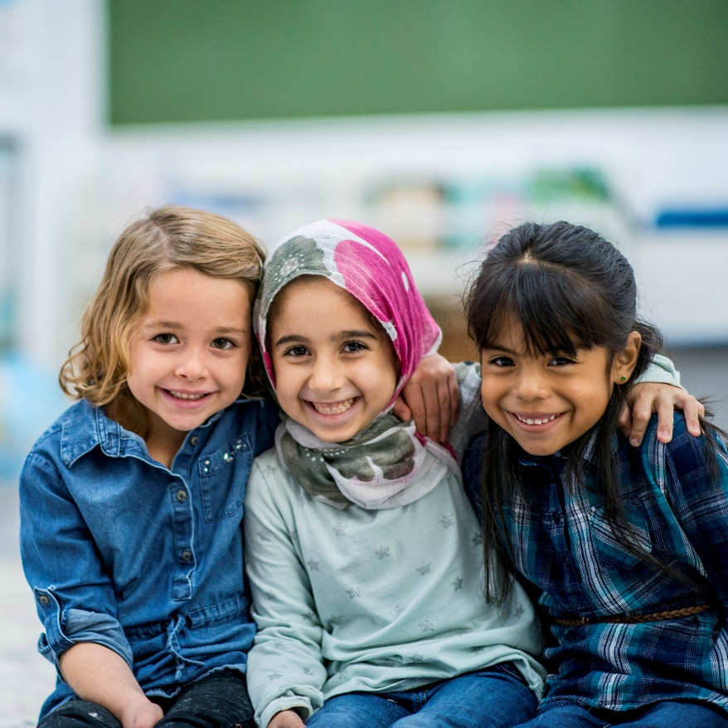
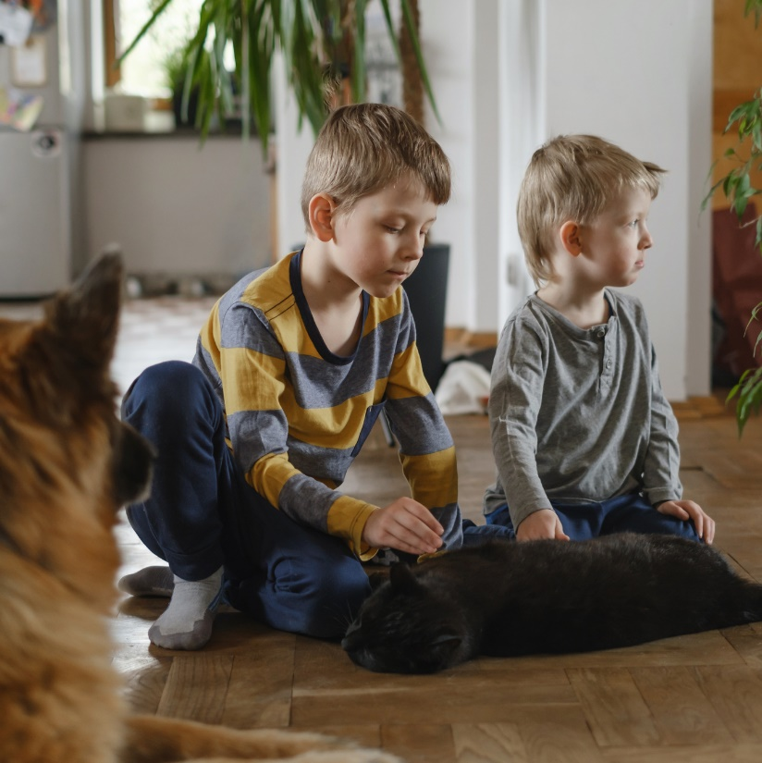
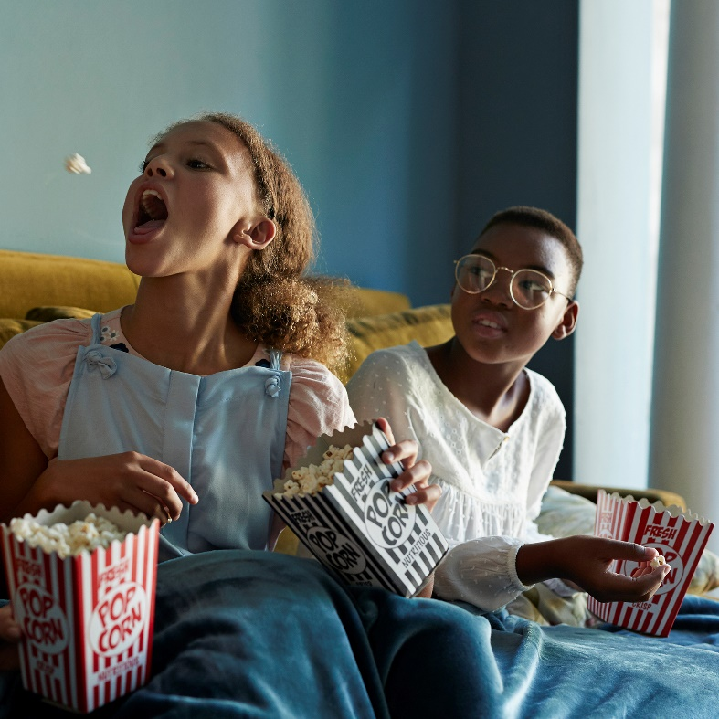
Spot the differences
It’s completely normal for people to have different views. It’s what makes life interesting!
When people feel comfortable to share their views, it helps us to learn new things about each other and the world around us.
Pair activity (5-10 mins)
Over the next few slides, you are going to read different people’s views. For each example, discuss in pairs whether their views are similar or different.
Notes:
Images
Microsoft Office 365
iStock

Slide 9
Spot the differences
Salty popcorn is my favourite!
Sweet’s my favourite!
Are their views similar or different?
©VotesforSchools2023
Notes:
Images
Microsoft Office 365
References
…

Slide 10
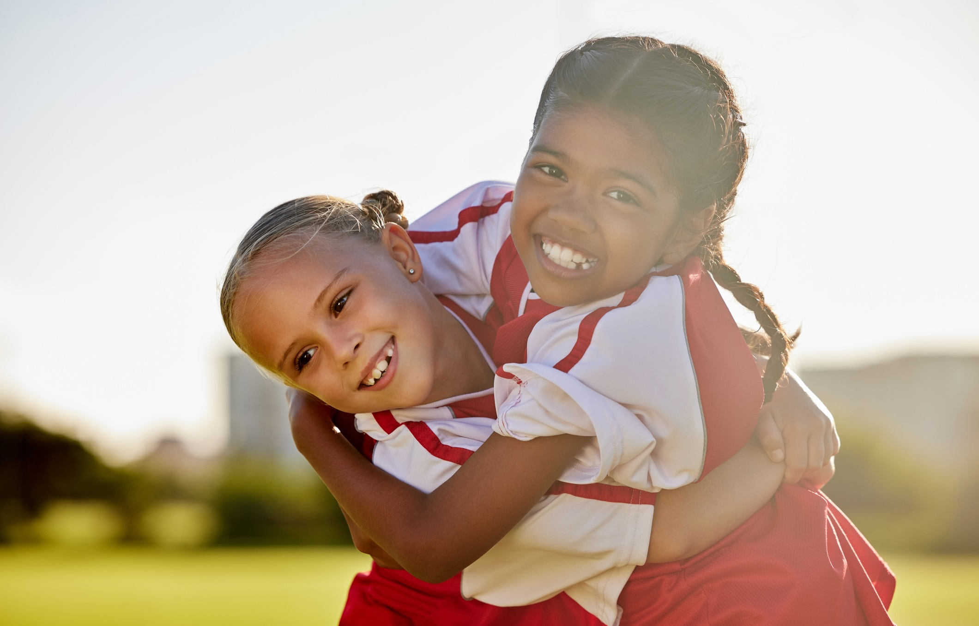
Spot the differences
I hope Arsenal win on Sunday!
I support Arsenal too!
Are their views similar or different?
©VotesforSchools2023
Notes:
Images
iStock
References
…

Slide 11
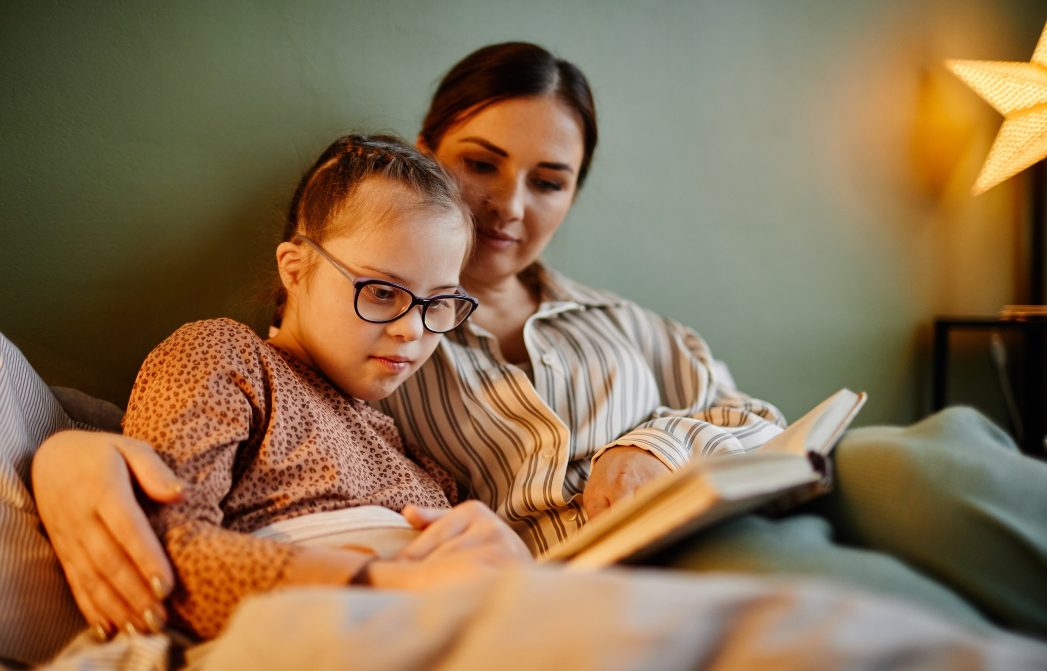
Spot the differences
I love reading books by Jaqueline Wilson.
She’s a fantastic author!
Are their views similar or different?
©VotesforSchools2023
Notes:
Images
iStock
References
…

Slide 12
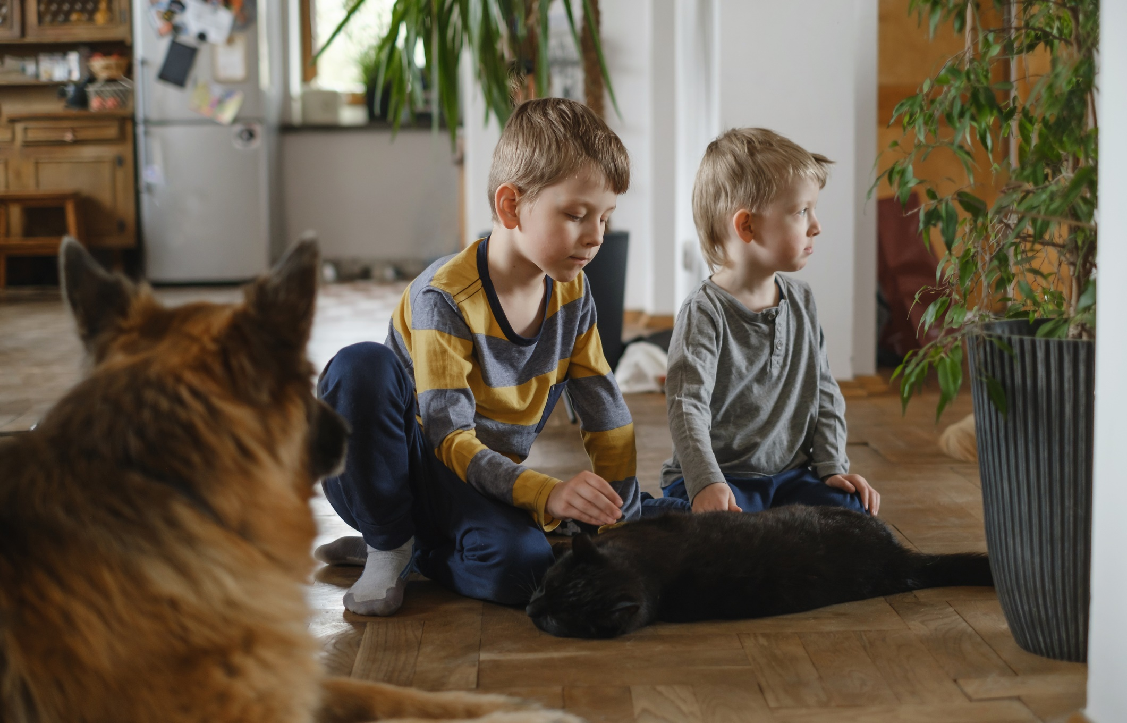
Spot the differences
The cat’s lovely, but dogs are my favourite animal.
Cats are the best!
Across the curriculum – Science:
Are dogs herbivores, carnivores or omnivores?
Are their views similar or different?
©VotesforSchools2023
Notes:
Images
iStock
References
…

Slide 13
Spot the differences
My mum said I’m old enough to make my own way to school.
My dad said the same!
Are their views similar or different?
©VotesforSchools2023
Notes:
Images
iStock
References
…

Slide 14
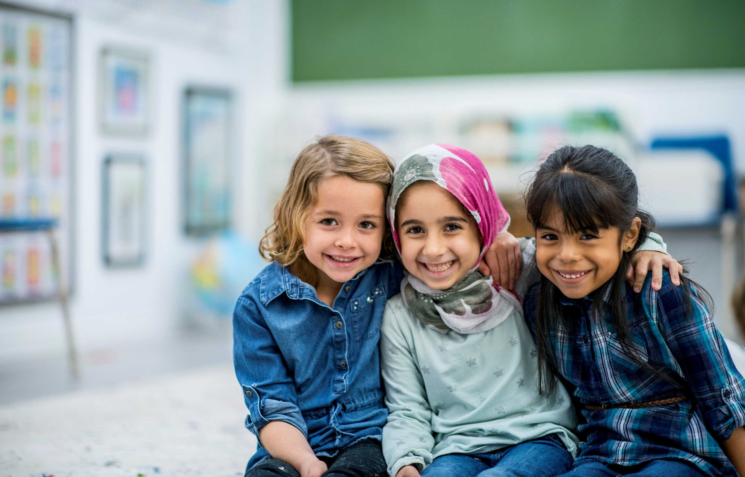
Spot the differences
I am Hindu.
I don’t have any religious beliefs.
I am Muslim.
Are their views similar or different?
©VotesforSchools2023
Notes:
Images
Microsoft Office 365
References
…

Slide 15
Starter: Viewfinder
Spot the differences
Why are we talking about this?
Taking it to the extreme
Life through a lens
Vote!
Notes:
Images
https://icons8.com/icon/23429/elections
https://icons8.com/icon/13470/opera-glasses
https://icons8.com/icon/97192/popcorn
https://icons8.com/icon/110287/thinking-bubble
https://icons8.com/icon/13191/class
https://icons8.com/icon/40845/school-backpack

Slide 16
Why are we talking about this?
Though people are encouraged to have different views, it’s important that everyone’s opinions are respectful towards other people.
Democracy
The rule of law
This idea is reflected in the five British Values that help us to make sure that everyone living in the UK feels safe, happy and healthy.
Individual liberty
Mutual respect
You can find out more about British Values in this week’s assembly.
Challenge:
Can you explain what each British Value means?
Tolerance
©VotesforSchools2023
Notes:
Images
Pixabay
References
https://www.gov.uk/government/news/guidance-on-promoting-british-values-in-schools-published
https://www.youtube.com/watch?v=Z9mcHpPvH9w

Slide 17
Why are we talking about this?
Democracy
Sometimes, people can have extreme views.
The rule of law
Extreme views:
Having such strong opinions or beliefs that most people cannot agree with you.
Individual liberty
When people have extreme views, it means their opinions go against the five British Values.
Mutual respect
Tolerance
©VotesforSchools2023
Notes:
Images
Pixabay
References
https://dictionary.cambridge.org/dictionary/learner-english/extreme
https://www.gov.uk/government/news/guidance-on-promoting-british-values-in-schools-published

Slide 18
Why are we talking about this?
Democracy
In recent years, more teenagers are hearing extreme views, either in real life or online.
The rule of law
Individual liberty
So, can you tell if someone has extreme views? Let’s find out today…
Mutual respect
Tolerance
©VotesforSchools2023
Notes:
Images
Pixabay
References
https://www.bbc.co.uk/news/uk-wales-64399335
https://www.gov.uk/government/statistics/individuals-referred-to-and-supported-through-the-prevent-programme-april-2021-to-march-2022/individuals-referred-to-and-supported-through-the-prevent-programme-april-2021-to-march-2022

Slide 19
Starter: Viewfinder
Spot the differences
Why are we talking about this?
Taking it to the extreme
Life through a lens
Vote!
Notes:
Images
https://icons8.com/icon/23429/elections
https://icons8.com/icon/13470/opera-glasses
https://icons8.com/icon/97192/popcorn
https://icons8.com/icon/110287/thinking-bubble
https://icons8.com/icon/13191/class
https://icons8.com/icon/40845/school-backpack

Slide 20
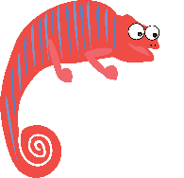
Taking it to the extreme
Individual activity (5-10 mins)
Over the next few slides, you will read some different views. For each one, decide how extreme their view is using your fingers as a scale from one to five. If it is not an extreme view, show one finger. If it is a bit extreme, show three fingers. If it is extreme, show five fingers.
This is not extreme!
This is a bit extreme!
This is extreme!
Notes:
Images
Microsoft Office 365

Slide 21
Taking it to the extreme
Liam doesn't agree
with everything that the five British Values say. So he stays behind to discuss them with
his teacher.
This is not extreme!
This is a bit extreme!
This is extreme!
Notes:
Images
Microsoft Office 365

Slide 22
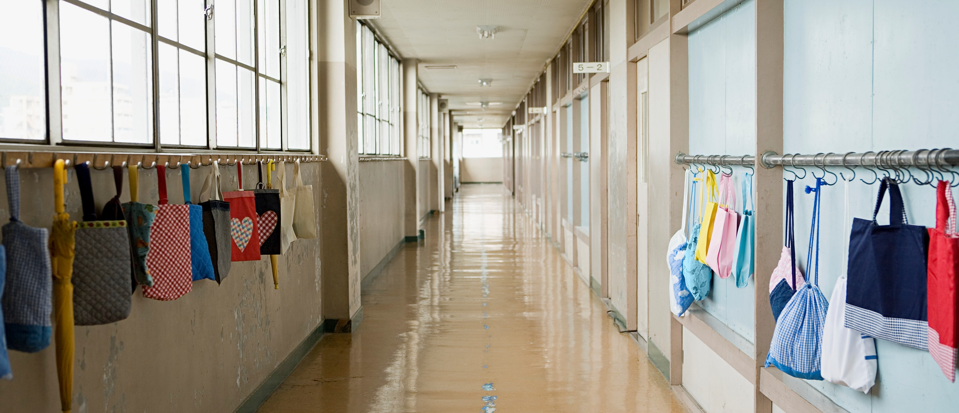
Taking it to the extreme
Ana's mum has told her not to talk to Sara because she doesn’t agree with Sara’s beliefs. But Ana likes Sara.
This is not extreme!
This is a bit extreme!
This is extreme!
©VotesforSchools2023
Notes:
Images
Microsoft Office 365

Slide 23
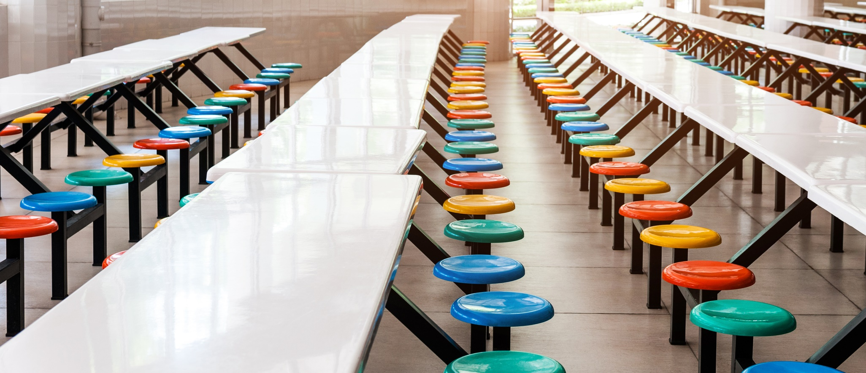
Taking it to the extreme
Miriam wants to find a way to tackle climate change, so she's started a protest in the dinner hall to get people to stop using plastic.
This is not extreme!
This is a bit extreme!
This is extreme!
Notes:
Images
iStock

Slide 24
Taking it to the extreme
Racism:
Unfair treatment by people or organisations due to a person's race (ethnicity, skin colour, hair texture, background).
John uses his YouTube channel to share his views. Sometimes, he uses racist words to get his point across.
This is not extreme!
This is a bit extreme!
This is extreme!
©VotesforSchools2023
Notes:
Images
Unsplash
References
https://dictionary.cambridge.org/dictionary/english/racism

Slide 25
Taking it to the extreme
These views are not extreme. It’s okay to make your voice heard by sharing your thoughts with others.
Miriam wants to find a way to tackle climate change, so she's started a protest in the dinner hall to get people to stop using plastic.
Liam doesn't agree
with everything that the five British Values say. So he stays behind to discuss them with his teacher.
Notes:
Images
Microsoft Fluent Emoji – Via Emojipedia
Microsoft Office 365
Unsplash
iStock
Pixabay
References
…

Slide 26
Taking it to the extreme
These are extreme views. They go against British Values and are disrespectful towards others.
Ana's mum has told her not to talk to Sara because she doesn’t agree with Sara’s beliefs. But
Ana likes Sara.
John uses his YouTube channel to share his views. Sometimes, he uses racist words to get his point across.
Notes:
Images
Microsoft Fluent Emoji – Via Emojipedia
Microsoft Office 365
Unsplash
iStock
Pixabay
References
…

Slide 27
Starter: Viewfinder
Spot the differences
Why are we talking about this?
Taking it to the extreme
Life through a lens
Vote!
Notes:
Images
https://icons8.com/icon/23429/elections
https://icons8.com/icon/13470/opera-glasses
https://icons8.com/icon/97192/popcorn
https://icons8.com/icon/110287/thinking-bubble
https://icons8.com/icon/13191/class
https://icons8.com/icon/40845/school-backpack

Slide 28
Life through a lens
People may hear extreme views being shared in everyday life or online.
It’s important to think about who you can talk to if you think you’ve heard extreme views being shared.
Whole class activity
(4-6 mins)
On the next few slides, you are going to think about who you could talk to if you see or hear an extreme view. For each one,
discuss whether these people would be good people to speak to about your worries.
Notes:
Images
Pixabay

Slide 29
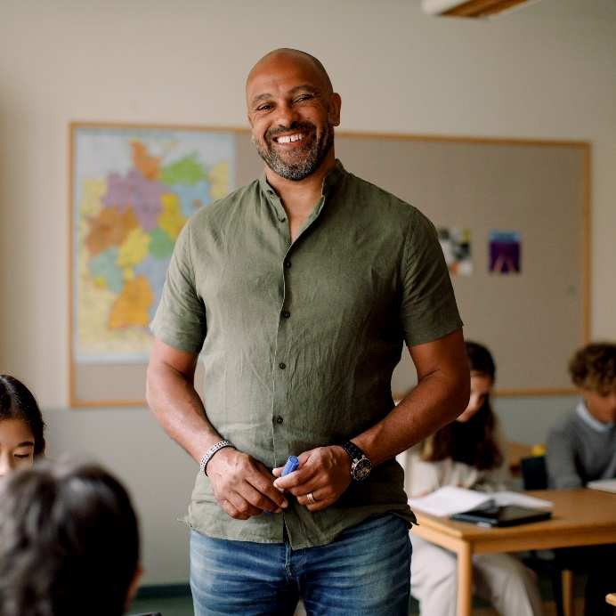
Life through a lens
Teacher
A teacher is a trusted adult you see every day. If you share any worries with them, they will find ways to help.
Would this be a good person to speak to?
Notes:
Images
Pixabay
Microsoft Office 365

Slide 30
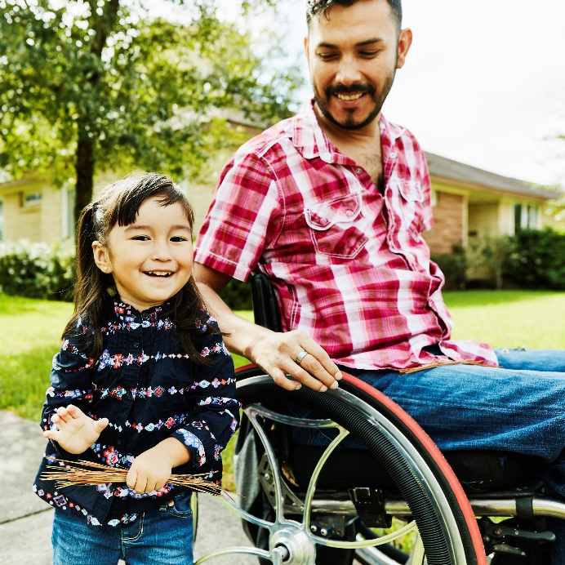
Life through a lens
Would this be a good person to speak to?
A parent or carer might share similar views to you. They can help if you hear or see any extreme views.
Parent or
carer
Notes:
Images
Pixabay
Microsoft Office 365

Slide 31
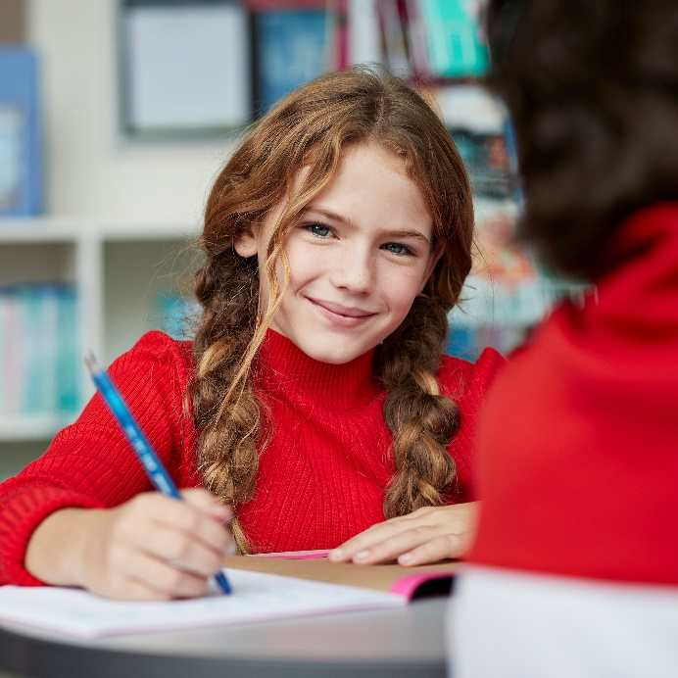
Life through a lens
A friend
Our friends are often our age, which means they can offer advice from the same viewpoint.
Would this be a good person to speak to?
Notes:
Images
Pixabay
Microsoft Office 365

Slide 32
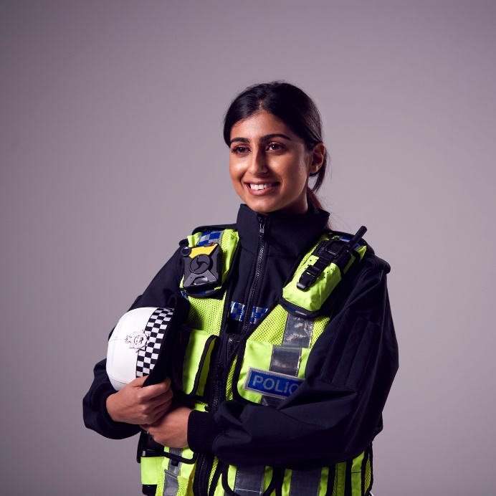
Life through a lens
Would this be a good person to speak to?
A police officer knows the laws we follow, so they can help us to understand right and wrong.
A police
officer
Notes:
Images
Pixabay
iStock

Slide 33
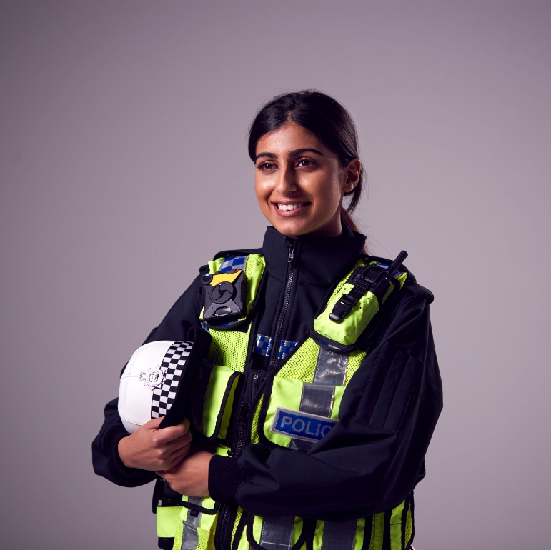
Life through a lens
Teacher
A friend
Whole class activity (2-3 mins)
Move to one of the four corners of the classroom to show who you think is the best person to speak to if you see or hear an extreme view.
Parent or
guardian
A police
officer
Notes:
Images
Microsoft Office 365
iStock

Slide 34
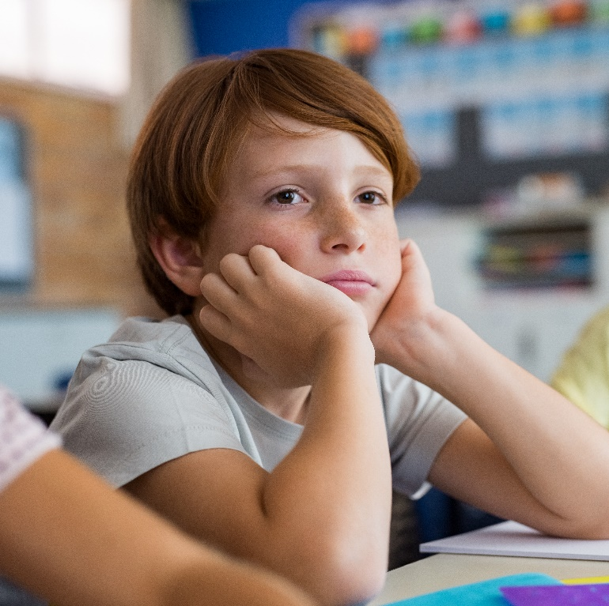
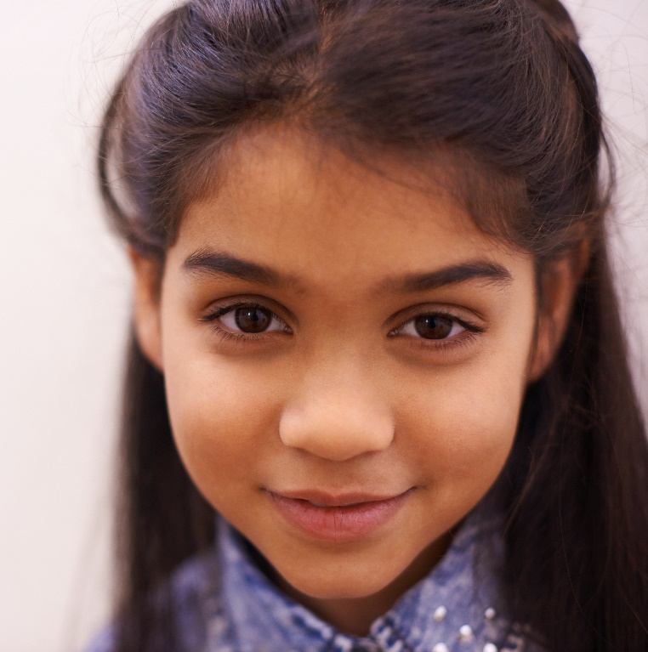
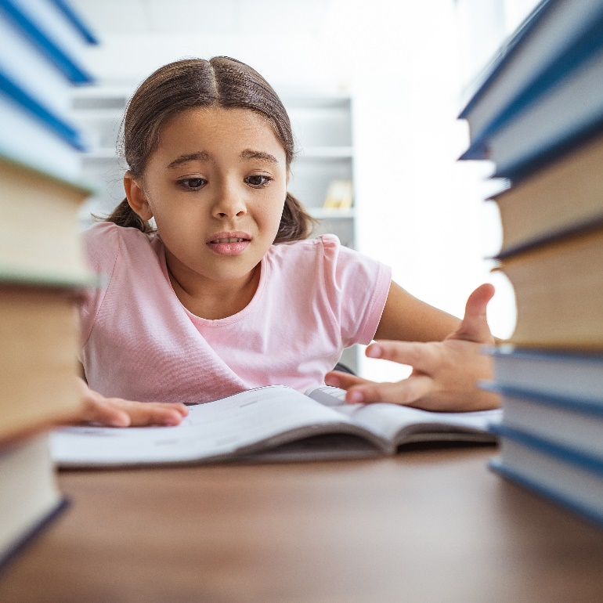
Life through a lens
Very
confident
Not
confident
Whole class activity (2-3 mins)
Move to one of the four corners of the classroom to show how confident you feel about knowing who to talk to if you see or hear extreme views.
Not sure
Quite
confident
Notes:
Images
Microsoft Office 365
iStock

Slide 35
Starter: Viewfinder
Spot the differences
Why are we talking about this?
Taking it to the extreme
Life through a lens
Vote!
Notes:
Images
https://icons8.com/icon/23429/elections
https://icons8.com/icon/13470/opera-glasses
https://icons8.com/icon/97192/popcorn
https://icons8.com/icon/110287/thinking-bubble
https://icons8.com/icon/13191/class
https://icons8.com/icon/40845/school-backpack

Slide 36
Vote!
When people have extreme views, it means their opinions go against the five British Values.
I am able to recognise which opinions disrespect other people.
I understand that it’s okay for people to have different opinions, but extreme views are unkind and unfair.
Can you recognise when someone has extreme views?
I’m not sure what the British Values are and how they affect people’s views.
I would need an adult to help me recognise which opinions disrespect others.
I find it difficult to understand which opinions are unkind and unfair towards others.
We will be sharing your thoughts on this topic with Exit Hate, Hope Not Hate, Jo Cox Foundation, Tony Blair Institute for Global Change and the Mayor's Office for Policing and Crime.
Log in to your VotesforSchools account to submit your vote and leave a comment.
©VotesforSchools2023
Notes:
Access your own or voters’ VotesforSchools accounts here: https://voice.votesforschools.com/#
Images
Unsplash

