Slide 2
Your latest results: “Should your role models be like you?”
“I feel they should be like you because I would like to follow the same path as my role model.”
Pheasant Bank Academy
“Yes, because my mum is my role model and she’s like me.”
Homerswood Primary & Nursery School
“Role models should not be like you because my role model has different qualities to me. This allows me to learn and aspire to better.”
Lea Forest Primary Academy
“No, everyone should be unique in their own ways as someone may inspire you, but they don’t have to be like you.” Holland House
School
Yes
No
22.9%
77.1%
43,270 young people voted this week! Were you one of them?

Slide 3
Your latest results: “Should your role models be like you?”
When you think of your own childhood role models, you might start to see how they mirror your own qualities and physical appearance. The same is true for our young people. This is why it is crucial that they are offered a diversity of aspirational people, who differ in age, ethnicity, gender, neurodiversity, physicality and abilities from themselves. When we learn how we admire others, it teaches us more about ourselves than we think. The VotesforSchools report illustrates how important understanding inspiration is in terms of our own self-awareness. Dreaming is just planning ahead after all!
Nic Ponsford
CEO and Founder
The Global Equality Collective
Notes:
Images
https://www.thegec.education/about-the-gec

Slide 4
Your views on “Should your role models be like you?” were also heard by:
The Equality Trust
Equally
Ours
Global Equality Collective
Close The
Gap
The Fawcett
Society
Notes:
Images
https://thegec.org/
https://twitter.com/EquallyOurs
https://twitter.com/equalitytrust
https://twitter.com/closethepaygap
https://www.facebook.com/FawcettSociety/
References
https://equalitytrust.org.uk/about-us
https://www.equallyours.org.uk/about-us/
https://www.thegec.education/about-the-gec
https://www.closethegap.org.uk/content/about/
https://www.fawcettsociety.org.uk/about

Slide 5
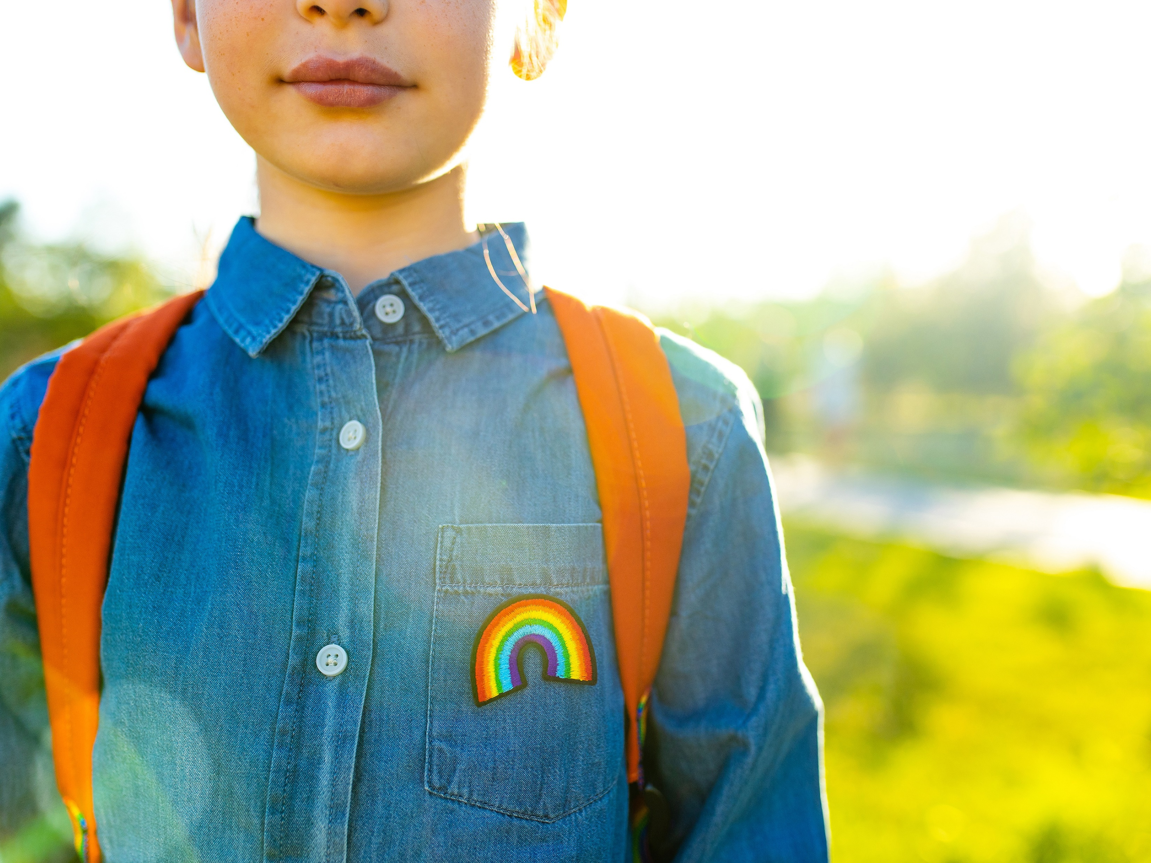
Today’s VoteTopic:
Do you know
how to be
an ally?
UNCRC Article 2:
No discrimination
UN SDG 10:
Reduced inequalities
VfS Key Theme 2:
Equalities & identity
Notes:
Images
Microsoft Office 365

Slide 6
1
Celebrating our differences
There are lots of ways that we can be different from the people around us.
Pair activity (2-3 mins)
Talk to your partner about how people can be different from each other.
Notes:
Images
Unsplash

Slide 7
1
Celebrating our differences
How many differences did you think of?
Skin colour
Hobbies
Age
Clothes
Height
Religion
Gender
Your family
Notes:
Images
Unsplash

Slide 8
2
Why are we talking about this?
Equality
Individual activity (1 min)
Which word can you see hidden in the word equality?
Notes:
Images
iStock

Slide 9
2
Why are we talking about this?
Equality
If you want to find out more about this, check out our assembly on protected characteristics.
In 2010, the UK passed a law called the Equality Act. This law was introduced to help everyone to be treated equally in all aspects of daily life.
Notes:
Images
iStock

Slide 10
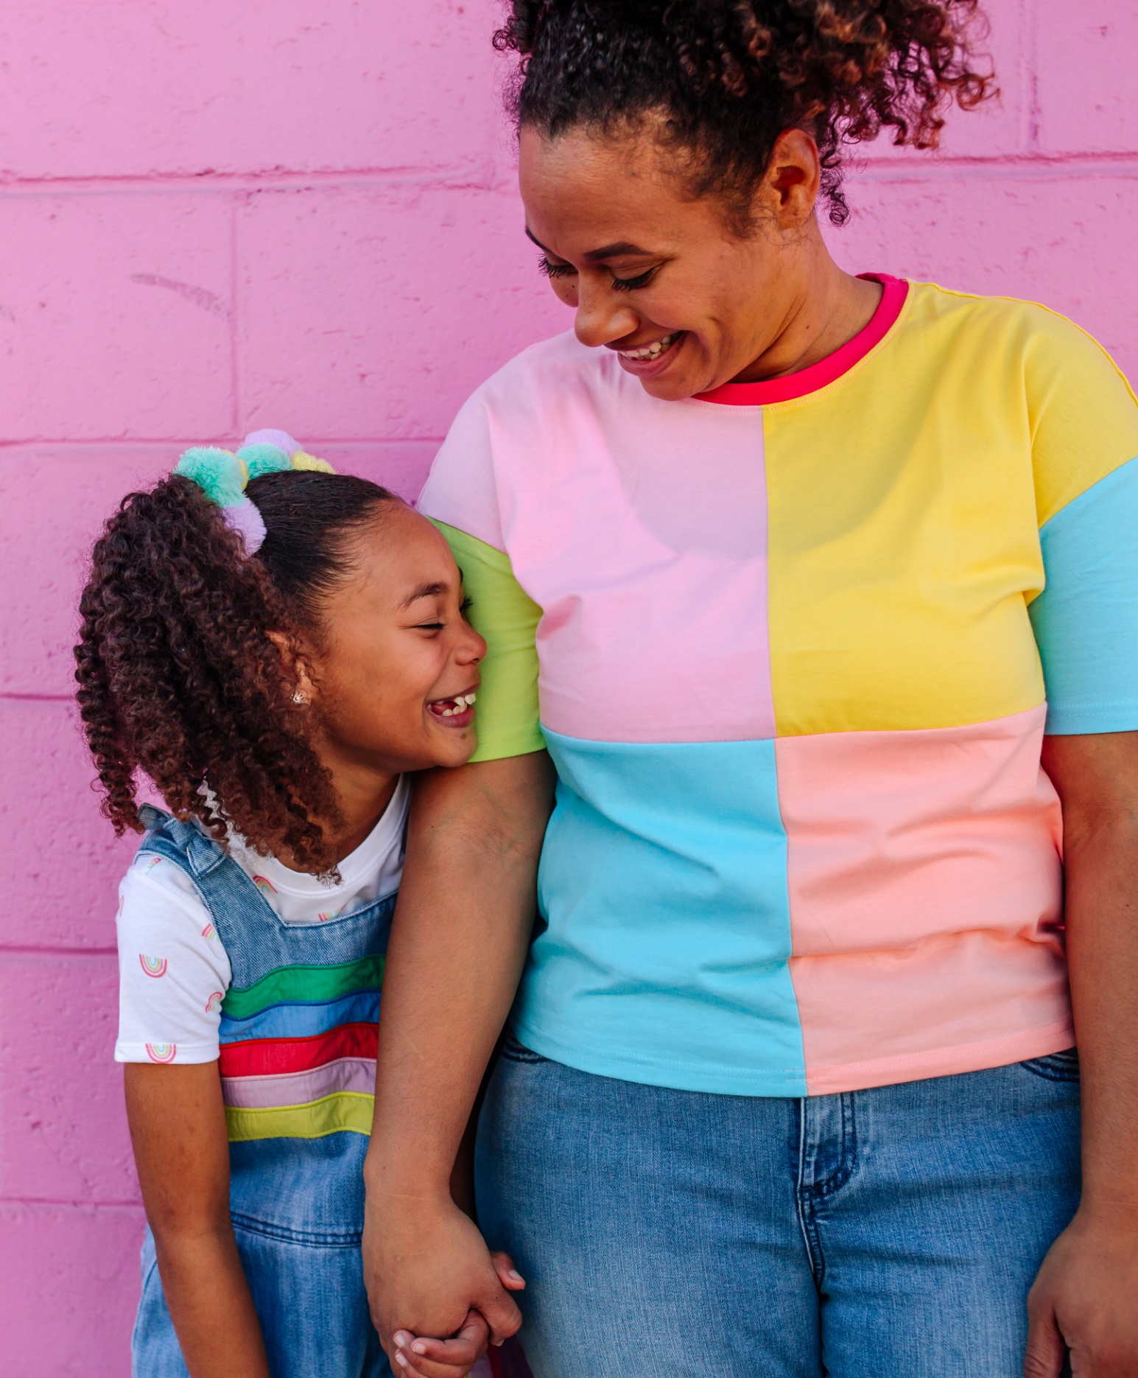
2
Why are we talking about this?
In 2024, people are still working out how to treat everyone equally.
Everyone in the UK has the right to protection against discrimination. This means that no one can treat anyone unfairly because of their characteristics.
Discrimination:
Unfair treatment of someone because of who they are.
Notes:
Images
Microsoft Office 365
References
https://dictionary.cambridge.org/dictionary/learner-english/discrimination
https://www.savethechildren.org.uk/content/dam/global/reports/uncrc-child-friendly-version1.pdf

Slide 11
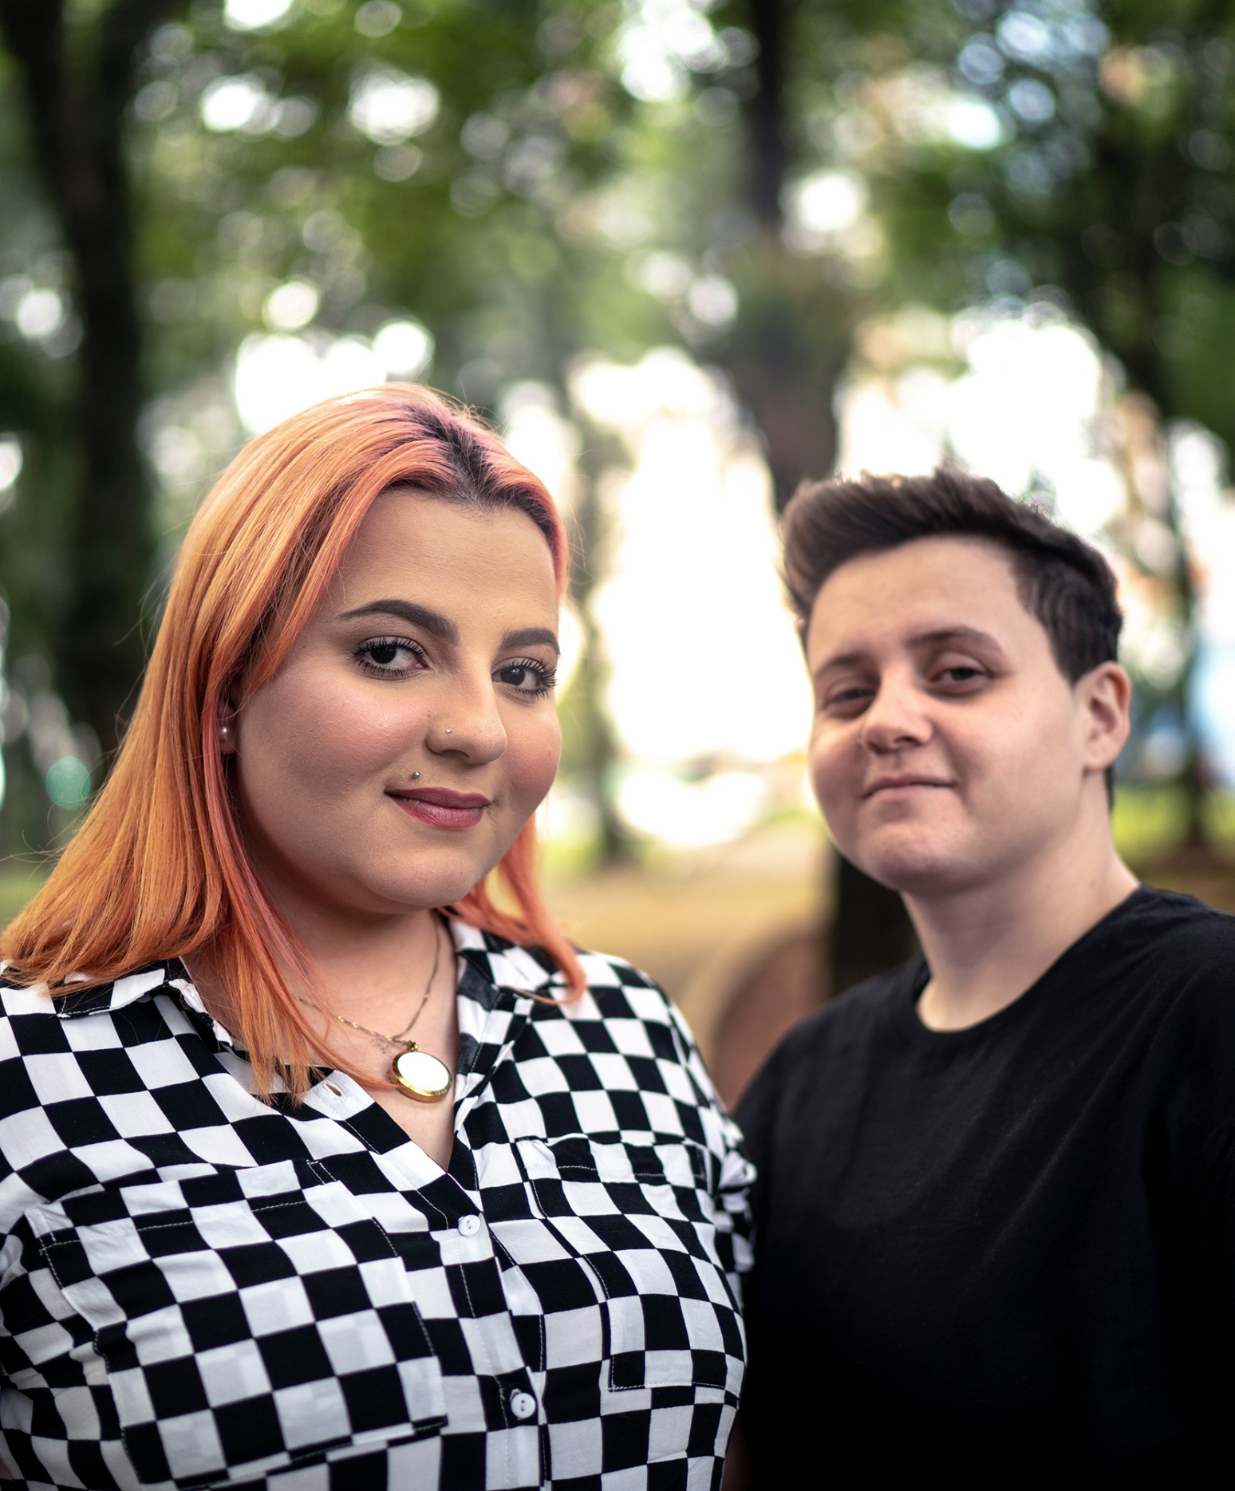
2
Why are we talking about this?
Sometimes in life, you might meet people who have been discriminated against.
When people do experience discrimination, some people think that allyship can help.
Ally:
While many people do their best to be considerate, being an ally requires more. An ally supports and stands up for people who are discriminated against.
Notes:
Images
Microsoft Office 365
References
https://business.scope.org.uk/article/how-to-be-a-disability-ally

Slide 12
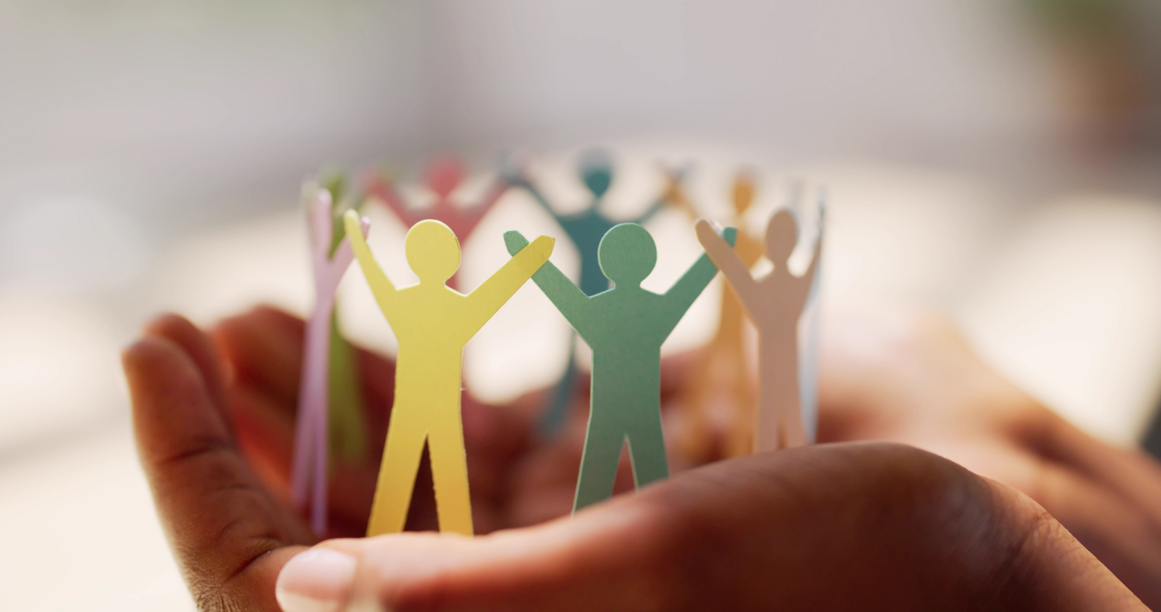
2
Why are we talking about this?
But do you know how to be an ally? Let’s explore this today.
Notes:
Images
Canva

Slide 13
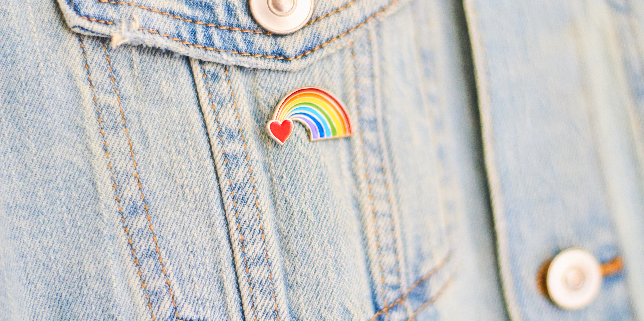
3
Friend or ally?
Allyship helps to make positive change for groups of people that have been treated unequally in the past and sometimes continue to be discriminated against today.
Challenge (1-2 mins)
Why might some groups of people need allies?
Notes:
Images
Microsoft Office 365

Slide 14
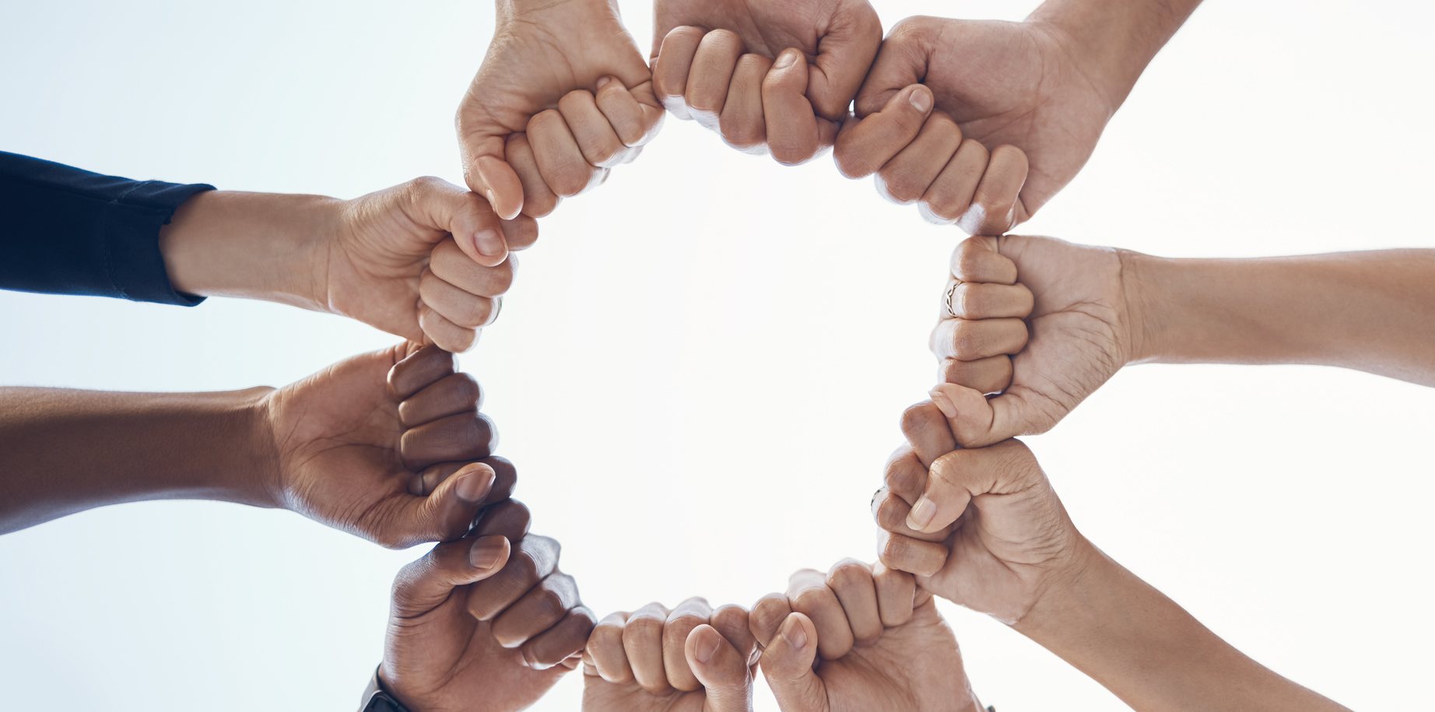
3
Friend or ally?
We all know how to stand up for our friends, but they’re not the only people we have to support. Being an ally means doing this and standing up for others no matter who they are.
Notes:
Images
iStock

Slide 15
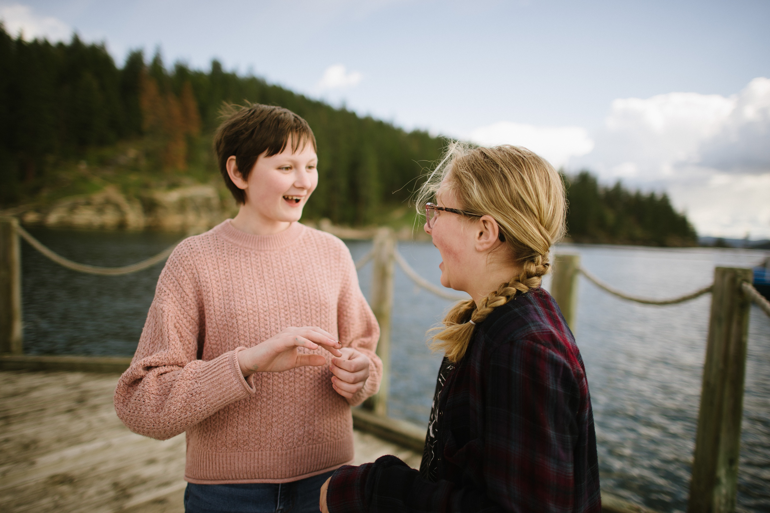
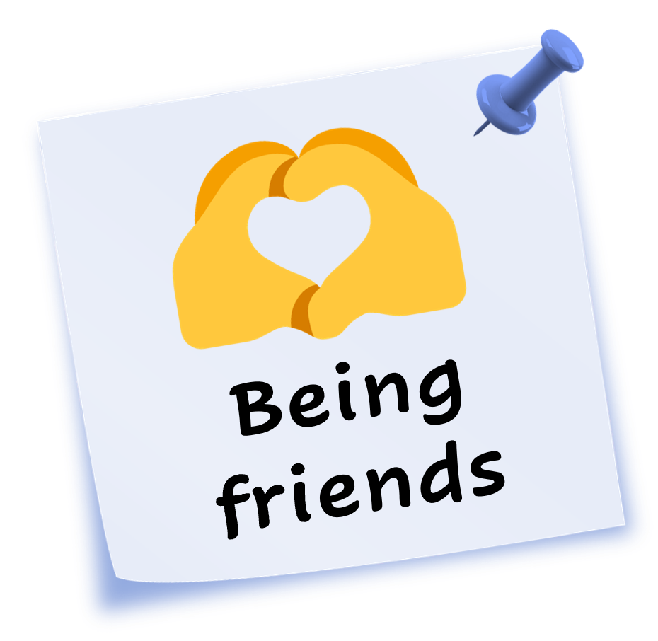
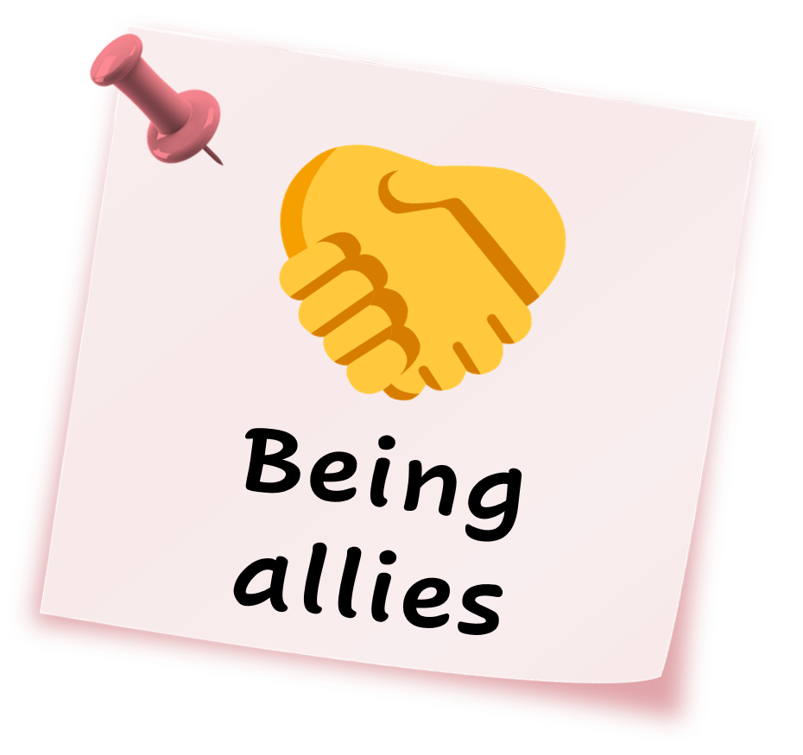
3
Friend or ally?
Whole class activity (5-10 mins)
On the next few slides, you will see some examples of people being friends, and people being allies. If you think an example is about being friends, make a heart shape. If you think it is about being allies, clasp your hands together.
Notes:
Images
iStock
Microsoft Fluent Emoji
Pixabay
Microsoft Office 365

Slide 16
3
Friend or ally?
Jordan and Drew are laughing
so hard at a joke together.
Every time they try to stop,
they just giggle even harder.
What do you think?
Notes:
Images
iStock
Microsoft Fluent Emoji
Pixabay
Microsoft Office 365

Slide 17
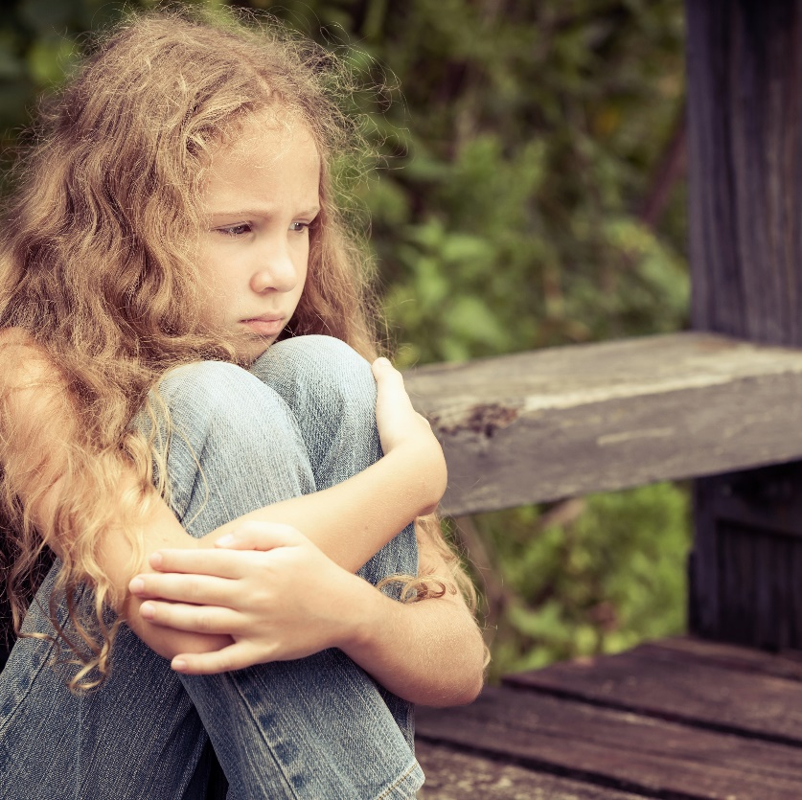
3
Friend or ally?
Bailey is pushed over in the
playground on purpose.
Ash sees and goes to tell an
adult exactly what happened.
What do you think?
Notes:
Images
iStock
Microsoft Fluent Emoji
Pixabay

Slide 18
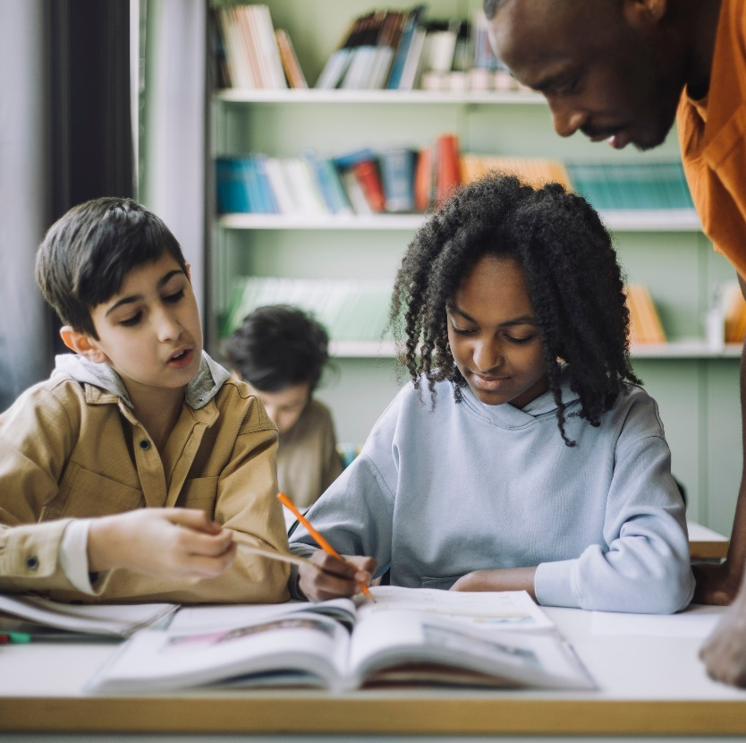
3
Friend or ally?
Gina sees that Noah is finding
their maths work tricky.
Gina shows Noah how to solve
one of the word problems.
What do you think?
Notes:
Images
iStock
Microsoft Fluent Emoji
Pixabay
Microsoft Office 365

Slide 19
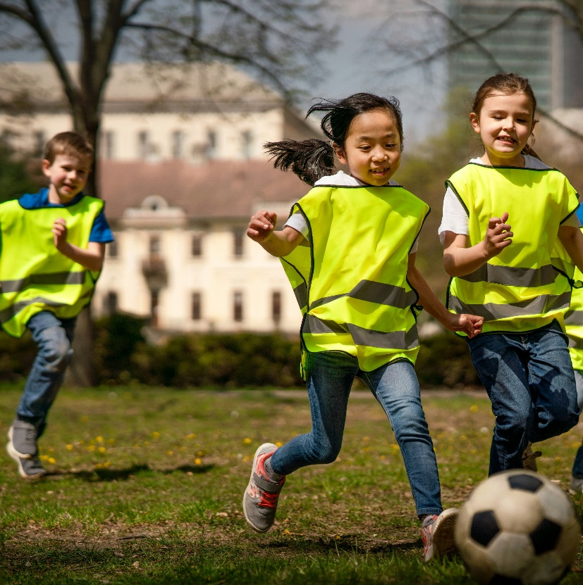
3
Friend or ally?
Ali, Jan and Avery play football
together at lunchtime.
They argue about a goal, but
they sort it out between them.
What do you think?
Notes:
Images
iStock
Microsoft Fluent Emoji
Pixabay

Slide 20
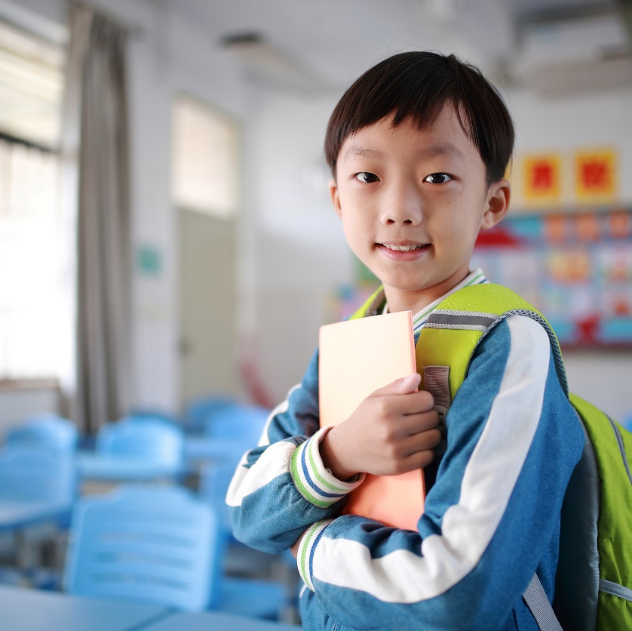
3
Friend or ally?
Charlie always moves away
from Riley at lunchtime.
Mark thinks this is unkind
and tells his teacher.
What do you think?
Notes:
Images
iStock
Microsoft Fluent Emoji
Pixabay
Microsoft Office 365

Slide 21
4
Thinking practicALLY…
Let’s think about how people can be allies to one another.
Pair activity (5-10 mins)
Over the next few slides, you will read about ways that people can be allies to one another. Guess the missing word to complete each sentence.
Notes:
Images
Microsoft Office 365

Slide 22
4
Thinking practicALLY…
L _ _ _ _ n to people who have been discriminated against.
What is the missing word?
Notes:
Images
iStock
References
https://business.scope.org.uk/article/how-to-be-a-disability-ally

Slide 23
4
Thinking practicALLY…
Listen to people who have been discriminated against.
Listening to people’s experiences helps them feel seen and heard.
Notes:
Images
iStock
References
https://lgbtqrolla.org/allyship/
https://business.scope.org.uk/article/how-to-be-a-disability-ally

Slide 24
4
Thinking practicALLY…
Think about the w _ _ _ s
you use.
What is the missing word?
Notes:
Images
iStock
References
https://business.scope.org.uk/article/how-to-be-a-disability-ally

Slide 25
4
Thinking practicALLY…
Think about the words
you use.
Thinking about the way we speak to people is important because words show our respect and support to others.
Notes:
Images
iStock
References
https://business.scope.org.uk/article/how-to-be-a-disability-ally

Slide 26
4
Thinking practicALLY…
S _ _ _ k up against discrimination.
What is the missing word?
Notes:
Images
iStock
References
https://business.scope.org.uk/article/how-to-be-a-disability-ally

Slide 27
4
Thinking practicALLY…
Speak up against discrimination.
Remember to speak to a trusted adult if you or someone you know is being discriminated against.
Notes:
Images
iStock
References
https://business.scope.org.uk/article/how-to-be-a-disability-ally

Slide 28
4
Thinking practicALLY…
L _ _ _ n more about different people’s stories.
What is the missing word?
Notes:
Images
iStock
References
https://business.scope.org.uk/article/how-to-be-a-disability-ally

Slide 29
4
Thinking practicALLY…
Learn more about different people’s stories.
Learning about different people’s stories can help everyone understand more about one another and be better allies.
Notes:
Images
iStock
References
https://business.scope.org.uk/article/how-to-be-a-disability-ally

Slide 30
4
Thinking practicALLY…
A _ _ _ _ t people for who
they are.
What is the missing word?
Notes:
Images
iStock
References
https://business.scope.org.uk/article/how-to-be-a-disability-ally

Slide 31
4
Thinking practicALLY…
Accept people for who
they are.
Everyone is different and that’s what makes life interesting.
It’s important to celebrate what makes people who they are!
Notes:
Images
iStock
References
https://business.scope.org.uk/article/how-to-be-a-disability-ally

Slide 32
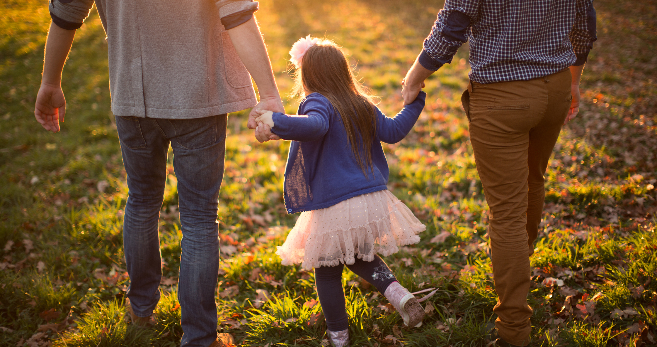
4
Thinking practicALLY…
Remember that becoming a good ally is a journey. It is okay if you make mistakes. You can learn from your mistakes and grow.
Notes:
Images
Microsoft Office 365
References
https://business.scope.org.uk/article/how-to-be-a-disability-ally

Slide 33
5
Pearls of wisdom
Now we’re going to read a book called Julián is a Mermaid. This book celebrates people being who they are and encourages everyone to live out their dreams!
Whole class activity (5-10 mins)
Click the play button below to open the story. Over the next few slides, pause the story to answer the question on screen.
5:03
Notes:
SafeShare Link: https://safeshare.tv/x/ss65f06b017c937 (0:00-5:03)
YouTube Link: https://www.youtube.com/watch?v=62HGRe_QuhU (0:00-5:24) BSL Version: https://www.youtube.com/watch?v=3PBi9dgDU0g
Images
iStock
Pixabay
References
https://www.booktrust.org.uk/book/j/julian-is-a-mermaid/

Slide 34
5
Pearls of wisdom
Curriculum link – Languages
What is the Spanish word for granny?
Pause the story at 1:39.
What does Julián imagine when he’s reading his book?
Notes:
SafeShare Link: https://safeshare.tv/x/ss65f06b017c937 (0:00-5:03)
YouTube Link: https://www.youtube.com/watch?v=62HGRe_QuhU (0:00-1:00) BSL Version: https://www.youtube.com/watch?v=3PBi9dgDU0g
Images
iStock
Pixabay

Slide 35
5
Pearls of wisdom
Pause the story at 2:27.
When does Julián tell his granny that he’s a mermaid?
Notes:
SafeShare Link: https://safeshare.tv/x/ss65f06b017c937 (0:00-5:03)
YouTube Link: https://www.youtube.com/watch?v=62HGRe_QuhU (0:00-1:00) BSL Version: https://www.youtube.com/watch?v=3PBi9dgDU0g
Images
iStock
Pixabay

Slide 36
5
Pearls of wisdom
Pause the story at 3:30.
Why does Julián say “Uh oh”?
Notes:
SafeShare Link: https://safeshare.tv/x/ss65f06b017c937 (0:00-5:03)
YouTube Link: https://www.youtube.com/watch?v=62HGRe_QuhU (0:00-1:00) BSL Version: https://www.youtube.com/watch?v=3PBi9dgDU0g
Images
iStock
Pixabay

Slide 37
5
Pearls of wisdom
Pause the story at 4:45.
Where does Julián go with his granny?
Notes:
SafeShare Link: https://safeshare.tv/x/ss65f06b017c937 (0:00-5:03)
YouTube Link: https://www.youtube.com/watch?v=62HGRe_QuhU (0:00-1:00) BSL Version: https://www.youtube.com/watch?v=3PBi9dgDU0g
Images
iStock
Pixabay

Slide 38
5
Pearls of wisdom
Answer at the end of the story.
Challenge (1-2 mins)
Why might Julián need an ally?
Who is an ally to Julián?
Notes:
SafeShare Link: https://safeshare.tv/x/ss65f06b017c937 (0:00-5:03)
YouTube Link: https://www.youtube.com/watch?v=62HGRe_QuhU (0:00-1:00) BSL Version: https://www.youtube.com/watch?v=3PBi9dgDU0g
Images
iStock
Pixabay

Slide 39
5
Pearls of wisdom
Answer at the end of the story.
How does Julián feel at the end of the story?
Notes:
SafeShare Link: https://safeshare.tv/x/ss65f06b017c937 (0:00-5:03)
YouTube Link: https://www.youtube.com/watch?v=62HGRe_QuhU (0:00-1:00) BSL Version: https://www.youtube.com/watch?v=3PBi9dgDU0g
Images
iStock
Pixabay

Slide 40
Now’s your chance to vote on: “Do you know how to be an ally?”
Yes
I know that being an ally is supporting everyone’s equal rights.
I can speak up against discrimination to make positive change.
I can be an ally to someone who is not my friend, or different from me.
I think it is too tricky for me to understand what an ally is.
I feel too young to be an ally, it is something I will leave to adults.
I’d find it difficult to be an ally to someone who I didn’t know.
No
We will be sharing your thoughts on this topic with Just Like Us, The Proud Trust, Stonewall, Jessica Love, LGBT Foundation and MindOut.
Log in to your VotesforSchools account to submit your vote and leave a comment.

