Slide 2
Your latest results: “Should the gender of your role models matter?”
“It is easier to relate to someone who is the same as you. Girls and boys are treated differently.”
Ormiston Ilkeston Enterprise Academy
“It really depends on what the role model is admired for. You can have different role models for different parts of life.”
Ricards Lodge High School
“Even though we have different genders, it shouldn’t matter as to what gender our role models may be, since we are all equal either way.”
St Wilfrid's Church of England Academy
“We look for role models via inspiration, for what they have done rather than what their gender is.” Wanstead High School
Yes
No
19.6%
80.4%
43,270 young people voted this week! Were you one of them?

Slide 3
Your latest results: “Should the gender of your role models matter?”
When you think of your own childhood role models, you might start to see how they mirror your own qualities and physical appearance. The same is true for our young people. This is why it is crucial that they are offered a diversity of aspirational people, who differ in age, ethnicity, gender, neurodiversity, physicality and abilities from themselves. When we learn how we admire others, it teaches us more about ourselves than we think. The VotesforSchools report illustrates how important understanding inspiration is in terms of our own self-awareness. Dreaming is just planning ahead after all!
Nic Ponsford
CEO and Founder
The Global Equality Collective
Notes:
Images
https://www.thegec.education/about-the-gec

Slide 4
Your views on “Should the gender of your role models matter?” were also heard by:
The Equality Trust
Equally
Ours
Global Equality Collective
Close The
Gap
The Fawcett
Society
Notes:
Images
https://thegec.org/
https://twitter.com/EquallyOurs
https://twitter.com/equalitytrust
https://twitter.com/closethepaygap
https://www.facebook.com/FawcettSociety/
References
https://equalitytrust.org.uk/about-us
https://www.equallyours.org.uk/about-us/
https://www.thegec.education/about-the-gec
https://www.closethegap.org.uk/content/about/
https://www.fawcettsociety.org.uk/about

Slide 5
Today’s VoteTopic:
Would you know how to support a friend who came out as trans or non-binary?
UNCRC Article 2:
No discrimination
UN SDG 10:
Reduced inequalities
VfS Key Theme 2:
Equalities & identity
Notes:
Images
Microsoft Office 365

Slide 6
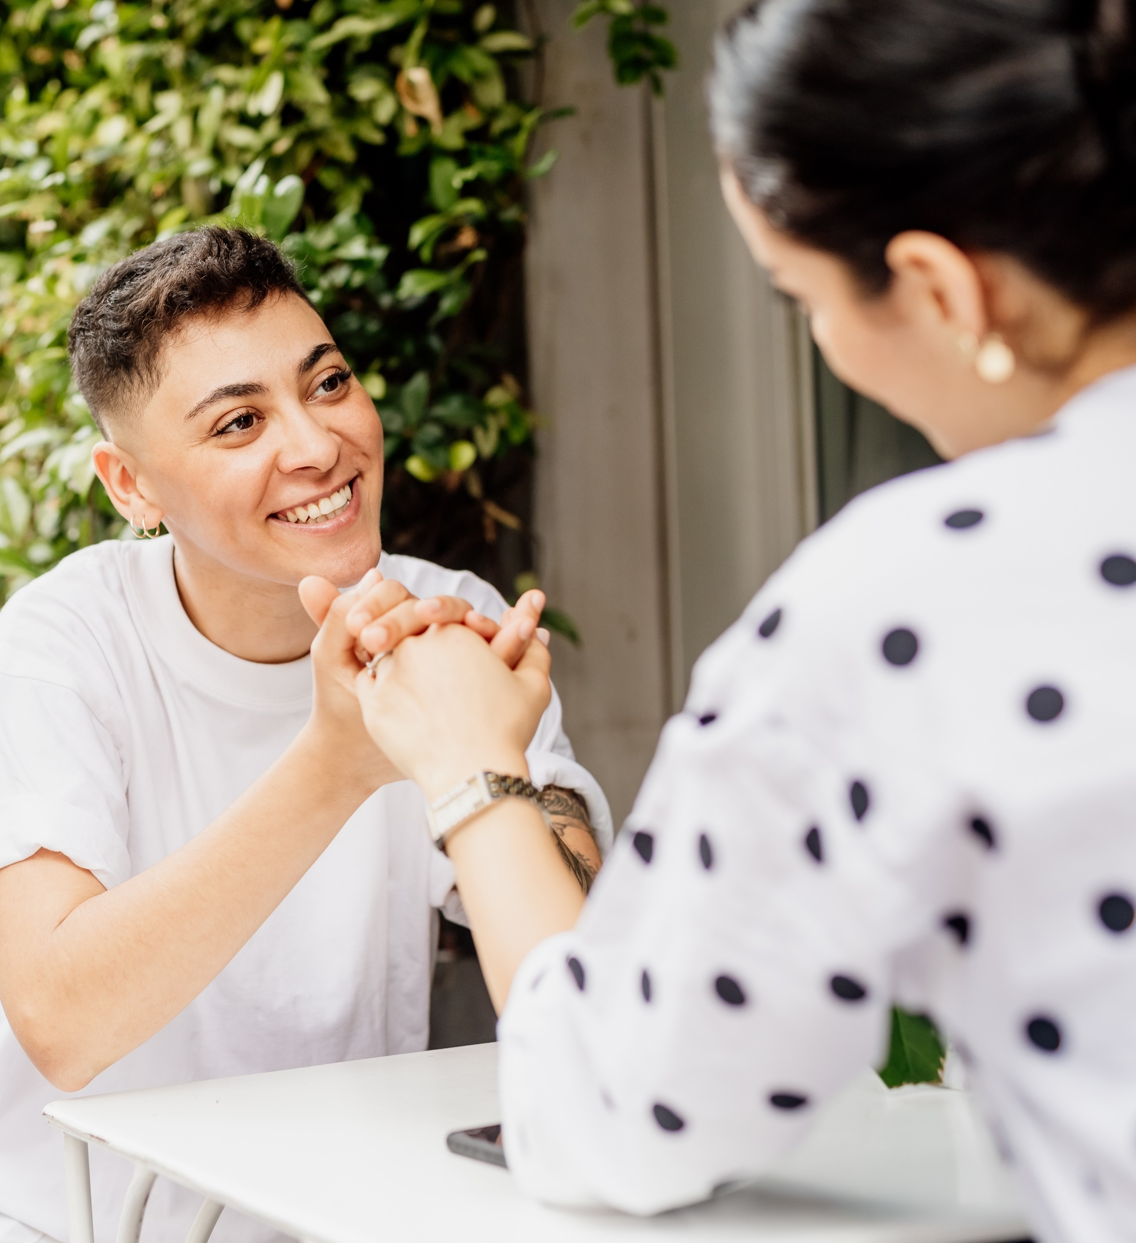
1
Why are we talking about this?
There are lots of conversations happening with, and about, trans and non-binary people at the moment.
Trans:
Shorthand for transgender, a term to describe people whose gender is not the same as, or does not sit comfortably with, the sex they were assigned at birth.
Non-binary:
A term for people whose gender identity doesn’t sit comfortably with “man” or “woman”.
Notes:
Images
Microsoft Office 365
References
https://www.stonewall.org.uk/list-lgbtq-terms

Slide 7
1
Why are we talking about this?
There have been discussions in the news and on socials. Conversations include how best to support trans and non-binary young people in schools.
There have been calls for the Government to give clear advice to schools in this area. Headlines were made when the Government published their draft guidance. For 12 weeks, people have been able to discuss whether they agree with this draft guidance. Now, the Government will make its final plans.
Notes:
Images
Unsplash +
References
https://educationhub.blog.gov.uk/2023/12/19/gender-questioning-children-guidance-schools-colleges/
https://consult.education.gov.uk/equalities-political-impartiality-anti-bullying-team/gender-questioning-children-proposed-guidance/supporting_documents/Gender%20Questioning%20Children%20%20nonstatutory%20guidance.pdf

Slide 8
1
Why are we talking about this?
Today you will be voting on: “Would you know how to support a friend who came out as trans or non-binary?” This lesson is an opportunity to reflect on some of the conversations that have been taking place and consider what support there can be in schools. We will also think about whether we are equipped to support a friend if they came out.
Coming out:
When someone chooses to share their LGBTQ+ identity with others.
Notes:
Images
Microsoft Office 365
References
https://www.stonewall.org.uk/young-futures/lgbtq-support/coming-out

Slide 9
2
The basics
There can be quite a lot of chatter about this topic. Thankfully, there’s a set of laws to guide how people must be treated: the Equality Act 2010.
Whole class activity (2-3 mins)
Click here to hear more about the Equality Act 2010.
2:41
The nine protected characteristics are looked at in more detail in this week’s assembly.
Notes:
SafeShare Video Link: https://safeshare.tv/x/VXLtKlmtrvM
YouTube Video Link: https://www.youtube.com/watch?v=VXLtKlmtrvM
Images
Microsoft Office 365
References
https://www.equalityhumanrights.com/equality/equality-act-2010
https://www.legislation.gov.uk/ukpga/2010/15/contents
https://www.gov.uk/guidance/equality-act-2010-guidance

Slide 10
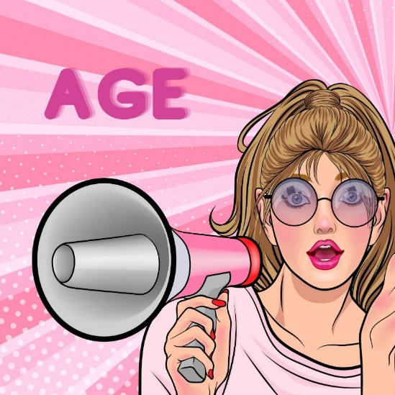
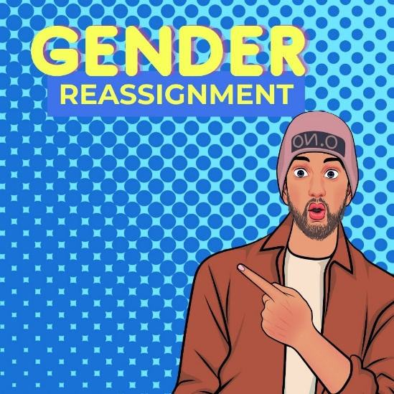
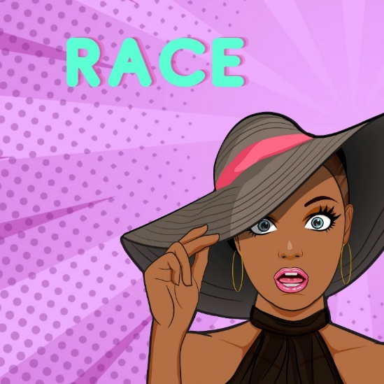
2
The basics
It is the law that there is no discrimination based on any of the nine protected characteristics.
Discrimination:
Treating a person or particular group of people differently, especially in a worse way than the way in which you treat other people, because of their race, gender, sexuality, etc.
Several of the protected characteristics apply to trans and non-binary people.
Notes:
Images
Unsplash
Canva
References
https://dictionary.cambridge.org/dictionary/english/discrimination
https://www.equalityhumanrights.com/equality/equality-act-2010

Slide 11
2
The basics
Did you know?
According to the 2021 census, 48,000 people identified as a trans man, 48,000 as a trans woman and 30,000 as non-binary. Altogether, these people make up around 0.1% of the total population in England and Wales.
Pair discussion (2-3 mins)
Is there discrimination against trans and non-binary people in schools?
Notes:
Images
Unsplash
References
https://www.ons.gov.uk/peoplepopulationandcommunity/culturalidentity/genderidentity/bulletins/genderidentityenglandandwales/census2021

Slide 12
3
Thinking practicALLY
Today you are voting on: “Would you know how to support a friend who came out as trans or non-binary?”
Just Like Us, the LGBT+ young people’s charity, found that 84% of young people would support a friend if they came out as trans and more than half say they already have a friend who is trans.
Helping and supporting someone who may be facing discrimination is often referred to as allyship.
Notes:
Images
Microsoft Office 365
References
Just Like Us
https://lgbtqrolla.org/allyship/

Slide 13
3
Thinking practicALLY
People can be allies for many causes.
The features of an ally can be described using its letters:
A
L
L
Y
Action
Listening
Learning
Yielding
Allies can take action such as sharing their preferred pronouns and speaking up in support when there are conversations that include forms of discrimination.
Being an ally can be as simple as listening to someone and accepting someone’s experiences are valid. It’s not always about offering solutions.
Self-education is a part of being an ally. It shouldn’t always be on an LGBTQ+ person to explain identities or talk through issues.
Yielding is when an ally takes a step back. Sometimes getting involved could cause more problems. Life can be very different for different people.
Notes:
Images
Unsplash
References
Just Like Us
https://lgbtqrolla.org/allyship/

Slide 14
3
Thinking practicALLY
Pair activity (4-6 mins)
Take a read of some scenarios on the following slides. Are the features of a good ally being demonstrated? Is there an opportunity to take action, to listen, to learn or to yield? Discuss your thoughts with your partner.
Notes:
Images
Unsplash
References
https://lgbtqrolla.org/allyship/

Slide 15
3
Thinking practicALLY
So, I took your advice and watched Heartstopper. It’s helped me understand what it is like being LGBTQ+ at school.
Action
Listening
Learning
Yielding
Notes:
Images
Unsplash +
References
https://lgbtqrolla.org/allyship/

Slide 16
3
Thinking practicALLY
Thanks for marching with me.
Obviously I’d be here.
Action
Listening
Learning
Yielding
Notes:
Images
Unsplash
References
https://lgbtqrolla.org/allyship/

Slide 17
3
Thinking practicALLY
I'm not like homophobic, I'm an ally.
Action
Listening
Learning
Yielding
Notes:
Images
iStock
References
https://lgbtqrolla.org/allyship/

Slide 18
3
Thinking practicALLY
I don’t have any advice at all. But I am here.
Action
Listening
Learning
Yielding
Notes:
Images
Microsoft Office 365
References
https://lgbtqrolla.org/allyship/

Slide 19
3
Thinking practicALLY
I’m frustrated that everyone in the group will not agree to share their preferred pronouns. I have been.
Action
Listening
Learning
Yielding
Notes:
Images
Unsplash +
References
https://lgbtqrolla.org/allyship/

Slide 20
3
Thinking practicALLY
Action
Listening
Learning
Yielding
Pair discussion (1-2 mins)
Consider the features of being an ally again. Which of these traits could make the biggest difference in decreasing discrimination towards trans and non-binary people?
Notes:
Images
Unsplash
References
https://lgbtqrolla.org/allyship/

Slide 21
Now’s your chance to vote on: “Would you know how to support a friend who came out as trans or non-binary?”
Yes
Thinking through the parts of A L L Y gives me a good starting point.
More positive media representation has helped me understand some of the ways I can support.
It’s reassuring to know that stepping back and appreciating that I won’t get all of it right
is okay.
I might not know at first, but I hope that I’ll be able to listen and learn pretty quickly.
I don’t know anyone that is trans or non-binary so I am not sure.
I worry that I can’t put myself in someone else's shoes and truly understand the best ways to support them.
No
We will be sharing your thoughts on this topic with Just Like Us, The Proud Trust, Stonewall, LGBT Foundation, MindOut & Gendered Intelligence.
Log in to your VotesforSchools account to submit your vote and leave a comment.

